Slide 1
5 reasons to Invest in Toulouse

Slide 2
5 reasons to Invest in Toulouse
September 2017
5 reasons to Invest in Toulouse
Cradle for tomorrow’s technologies
One of the most dynamic regions in Europe
2nd university city in France
Unique innovation campuses and business areas
A renowned quality of life that attracts talents

Slide 3
1. One of the most dynamic regions in Europe

Slide 4
1. One of the most dynamic regions in Europe
Some key facts about Toulouse
World capital of aeronautics
European capital of space industry
Toulouse plays a key role in international space projects such as Galileo, Curiosity (Mars) or Philae …
The A380, the largest plane in the world
25% of population are students
European capital of Science, the city will host the 2018 edition of the EuroScience Open Forum (ESOF)
Other important facts:
Jean Tirole, laureate of the Sveriges Riksbank Prize in Economic Sciences in Memory of Alfred Nobel in 2014
3 UNESCO World Heritage sites

Slide 5
1. One of the most dynamic regions in Europe
1st French metropolis for
Economic growth: +2,9%/year in GDP per capita – in Europe’s top 10 urban areas (of more than 1m people (400 in Europe), Eurostat Urban Europe 2016)
Demographic growth:
1,3m population – 4th French urban area
+200 000 people in 10 years – in Europe’s top 10 urban areas (Eurostat Urban Europe 2016)
Job creation: +70 000 employees in the private sector in 10 years
R&D investment: €5bn/year, 4,8% of PIB – in Europe’s top 10 regions (Eurostat 2013)
Balance of trade: +€8,7bn. in 2016 (France: - 64,6bn)
Employee and worker satisfaction: 1st city in 8 developed countries (Censuswide 2016 – in front of Halifax, Charlotte, Dortmund and Berlin)
Start-up creations (excluding Paris – Trendeo 2016)
TOULOUSE

Slide 6
1. One of the most dynamic regions in Europe
Toulouse, France’s city with the most job creations
In terms of job creation press releases in French media
According to the national investment observatory Trendeo
*Net job creations in France’s main cities since 2015
Major job creation announcements in 2017
820 jobs | 480 jobs | 300 jobs | 270 jobs | 150 jobs | 150 jobs | 100 jobs | 100 jobs

Slide 7
1. One of the most dynamic regions in Europe
Employment & Investment Observatory
Toulouse in France’s top 3 metropolises for:
#1
Number of fundraises
#2
Startup creation 2014 – 2016
#3
Job creation in startups
Source: Les Echos

Slide 8
1. One of the most dynamic regions in Europe
An international airport
Only 7km away from the city center
Highest rated French airport on flight-report.com (8,1/10) and the only French airport in the Top 20 worldwide
9m passengers in 2017 (up from 8m in 2016) 23 new routes (7 Ryanair routes) National (+2,6 %) international (+10,5 %) traffic growth
80 destinations (of which 63 international destinations) 120 daily departures
Number of daily direct flights to European major cities: Paris: 40 London: 10 Madrid: 8 Brussels: 4 Amsterdam: 3 Rome: 2 Berlin: 1, Munich 4, Frankfurt 3 Geneva: 1
Toulouse-Paris: Busiest air route in Europe with 2.3M passengers/year

Slide 9
2. Cradle for tomorrow’s technologies
Aeronautics and Space industry
Emerging technologies
Life Sciences

Slide 10
2. Cradle for tomorrow’s technologies
They chose Toulouse for their world HQs in 2016
In June 2016, Airbus Group inaugurated it world HQs in Toulouse
€100M investment in a 5,5ha facility welcoming 1500 employees.
Airbus represents 27,000 direct jobs and 85,000 indirect jobs in Toulouse
In June 2016, Siemens Mobility inaugurated its world HQs in Toulouse for its fully automatic VAL metro systems
A 10,000sqm facility welcoming 100 employees
In October 2016, AKKA Technologies, a technology consulting group, inaugurated its world HQs for its aeronautic activities
€30M investment
1000 employees and 500 more announced for 2017

Slide 11
2. Cradle for tomorrow’s technologies
A large choice of partners & contractors
AERONAUTICS
SPACE
INTELLIGENT TRANSPORTATION
HEALTH COSMETICS
DIGITAL

Slide 12
Aeronautics and space

Slide 13
2. Cradle for tomorrow’s technologies
World capital of aeronautics
25% of the French R&D in Aerospace
85,000 jobs in 700 companies
Airbus Group World HQ
718 planes delivered (up from 688 in ‘16) / 850 net orders in 2017
1st French industrial site: 650ha & 40k employees
Design, final assembly, flight tests
Notes:
Airbus Group world HQs: 27,000 employees in Toulouse
85 000 indirect jobs in 700 companies
25% of French R&D in aeronautics and space (€2bn from Airbus Aircraft/year)
635 planes delivered from Toulouse in 2015; 10 000th plane delivered from Toulouse in October 2016
Two main sites dedicated to aeronautics:
St Martin du Touch: 1st French industrial plant with 650ha et 40.000 employees
Toulouse Aerospace: New research and development campus in aeronautics, space and embedded systems of 56ha
Key industrial steps in Toulouse: Design, final assembling, flight tests

Slide 14
2. Cradle for tomorrow’s technologies
European capital of Space
25% of European workforce
12,000 jobs in 400 companies
French National Space Agency major site
Satellite imagery (SPOT IMAGE),
Meteorology (METEO France)
Oceanography (MERCATOR OCEAN)
Design et fabrication de satellites: 10,000 m² of clean rooms
OneWeb FAL opened mid 2017 using Airbus Group manufacturing capabilities
Exploration of Mars, International Space Station, Rosetta mission…

Slide 15
Emerging technologies

Slide 16
2. Cradle for tomorrow’s technologies
French Tech City
3,000 IT companies / 200+ startups & 78 newly founded since 2014
38,000 IT jobs / 1 298 startup jobs created since 2014
94 startups have raised 414M€ since 2014 / 11 have raised 185M€ in 2016
6 startups in Deloitte Technology Fast 500 2016 EMEA
20 public and private accelerators
163 R&D centers
20,000 highly qualified students
Internet of Things
Autonomous Sensing & Systems
Healthtech / Medtech
Creative Industries
Retail

Slide 17
2. Cradle for tomorrow’s technologies
A center of excellence for autonomous & connected vehicles
Hyperloop Transportation Technologies will soon launch its European R&D activities in Toulouse
Continental Digital Services France has its HQs in Toulouse, notably working on the eHorizon project to make autonomous and connected vehicles smarter and safer
Easy Mile develops its driverless shuttle in Toulouse
Renault has acquired Intel’s R&D capabilities in Toulouse to develop its Software Lab dedicated to autonomous and connected vehicles
SM World HQ: intelligent and efficient mobility solutions for urban, interurban and freight transportation
M3 Systems Specialized in the use of spatial technologies in transportation
LAAS is a world class research laboratory specialized in robotics, among the world leaders in the security of embedded systems
ACTIA 30 years of experience in embedded systems for buses, trucks and industrial vehicles
Robotics Place brings together companies, research laboratories and high-schools of the robotics and drones sector Automotech is the regional ground mobility association, a major local partner for this industry

Slide 18
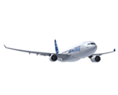
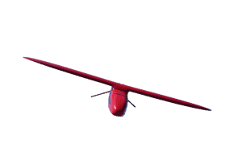
2. Cradle for tomorrow’s technologies
Home of transportation and space engineering
Ground

Slide 19
2. Cradle for tomorrow’s technologies
Unicorns in Toulouse
Hyperloop TT’s first European R&D center to open in Toulouse
€40M investment
50 engineers hired in 3 years
1km test track to be built before 2020
Global leader for electric autonomous shuttles, created in Toulouse in 2014
70 employees in Toulouse, Singapore and Denver
Alstom invested €14M in EasyMile in January 2017
Born in 2010 in Toulouse, Sigfox is the world’s leading Internet of Things service provider connecting 29 countries with a 1,7Mkm² coverage
With $310M in fundraises the multinationals Total, Telefonica and GDF Suez invested in Sigfox

Slide 20
2. Cradle for tomorrow’s technologies
Toulouse, the open métropole
Committed to a sustainable and smarter city, the Open Métropole aims at testing new technologies in the public environment
18 experimentations with local startups
8 public-private demonstrators: LTE in the metro, free high-speed WIFI around the city, smart management of clean water, innovative parking
15 emblematic projects: Data Platform for public data & connected devices, smart public lighting, autonomous vehicles
1 « Small Business Act » to involve all local SMEs in public projects with Toulouse Métropole and all its partners
€500M in public investment before 2020
€4 billion invested in big municipal projects (3rd metro line, Urban Cableway, high-frequency buses) Toulouse Métropole 1st public investor in France after Paris

Slide 21
Life sciences

Slide 22
2. Cradle for tomorrow’s technologies
The health sector is doing well in Toulouse!
Initiatives are growing to fight cancer, diabetes, obesity…with strong cross-fertilization with numerous cutting-edge technologies (space, IT…)
Dermatology, cosmetics, gerontology, cardiology, infectious disease…Toulouse is a global health research center!
Health is a leading sector for employment in the Occitanie region representing 18% of all employees (140 000 employees + 20000 self-employed)
9 000 public and private researchers in the health sector
20 000 jobs in the private sector including 10 000 in R&D: more than 200 SMEs and startups work daily with key actors such as Sanofi, Evotec or Pierre Fabre
→ Around 190 000 people work every day in the medical and health sector R&D in the Occitanie region
4,8 % of GDP is dedicated to R&D (1st region, 4th for medical R&D)
Toulouse focus: 15 000 students, 2 200 researchers in the health sector, 8 hospitals, 9 clinics, 110 companies gathering 3 500 employees and one major site: the Oncopole.

Slide 23
2. Cradle for tomorrow’s technologies
Leading sectors creating innovative research for better health
Deep Learning
Connectivity - Mobility
Robotics – Nuclear imaging
Training - Simulation tool
Epidemiology

Slide 24
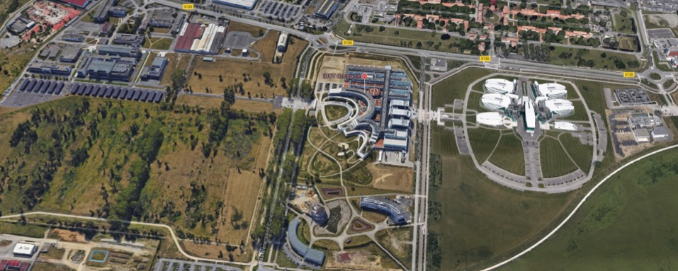
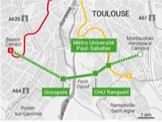
2. Cradle for tomorrow’s technologies
The Oncopole: a translational campus « de la santé à la beauté » for the future of health
* 540 acres (220ha)
* 1,2 billions€ of public/private investment
* 4000 employees work daily on site
Urban Cable car by 2020
Notes:
7 major activities to support your business & innovation
Medical care and clinical research (IUCT-O)
Public research (Inserm, CNRS, UPS – CRCT, ITAV…)
Private research (Pierre Fabre, Evotec, Cyclopharma, EFS…)
Innovation and technological transfer (incubator…)
Training organization (Oncorésonnance, UPS)
Supportive network (CBS cluster, TCS foundation)
Logistics support (hotels, restaurants…)
+evolution
+ medical research centers à l’exterieur

Slide 25
3. 2nd university city in France

Slide 26
3. 2nd university city in France
Numerous students and world class education
1st most student-favored city for higher education (L’Etudiant, 2015)
130 000 students, 15 000 foreign students
2nd oldest university in France, created in 1229
Federal University of Toulouse regrouping 23 higher education entities as well as 6 research institutes
4 universities
10 engineering schools
7 schools of higher education

Slide 27
3. 2nd university city in France
A top 10 R&D region in Europe
Midi-Pyrénées, 6st most R&D oriented region with expenses totaling 4.8% of GDP (cf. illustration)
1st French city for the annual arrival rate of highly educated workers (research and design executives: 6,17 for 1000 jobs; Paris 5,57 - Bordeaux 3,34; INSEE 2013)
1st French city in research intensity with 16.2 researchers for 1000 employees
1st French region for executives working in R&D: 40%
Main research centers and laboratories:

Slide 28
4. Unique innovation campuses and business areas

Slide 29
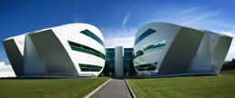
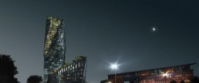
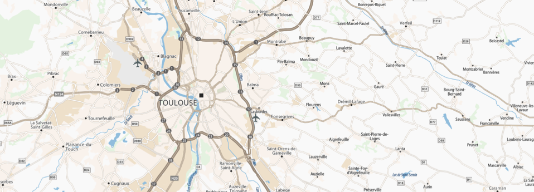
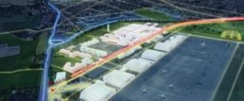
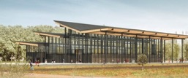
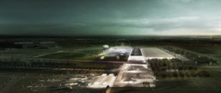
Oncopole campus
4. Unique innovation campuses and business areas
5 major urban development projects
Occitanie Tower
PEx Exhibition Park
70 000m² congress & convention center, delivered in 2020
Francazal Mobility Park
Toulouse Euro Sud Ouest
High-speed (LGV) rail station and new business district in 2024 Occitanie Tower: First skyscraper in Toulouse
Toulouse Aerospace
Toulouse Aerospace
New district dedicated to aeronautics, space and embedded systems
Francazal Mobility Park
Future excellence center in robotics, drones, autonomous vehicles and future transportation
PEx Exhibition Park
Oncopole
Cancer research center of European excellence – 220ha

Slide 30
4. Unique innovation campuses and business areas
An exceptional network of incubators and accelerators
Incubateur MIPY
12-month public incubator with coaching, fundraise support and repayable advance upon arrival
Greentech Météo France Piloted by the Environment Ministry and Météo France with focus on IoT at the service of energy transition
Catalis (Social Economy Incubator)
Première Brique (social innovation incubator)
ESA BIC SUD France Only European Space Agency incubator in France
FabLab Artilect
First French FabLab, created in 2009 with 3D printers, free access milling machines for entrepreneurs and member companies (FabLab Pro)
La Cantine
Coworking and networking place, coaching, crash tests for startups
Hosting the pre-incubation program Le Starter & the Numa Accelerator
Ekito
Startup accelerator via equity investments, coaching
Connected Camp
IoT Valley startup accelerator
Airbus BizLab
Corporate accelerator providing Airbus expertise and network to startups
Village by CA 31 Accelerator and innovation bank
Momentum CSR accelerator
Ethics Village accelerator
Le Hi-Lab Clinique Pasteur
L’atelier du 26 Talent accelerator
Banque Populaire Cybersécurité / Orange Fab France : Villa Tolosa
Pépinières Toulouse Métropole
20,000 m² of public incubator sites hosting about 100 young companies
HarryCow
Coworking devoted to foster cultural IT projects
Lab’Oïkos
3000 sqm of coworking dedicated to the positive economy
At Home Coworking
Le Hub by RBMG
Coworking and project mentoring
Etincelle / Imaginations Fertiles / Tau
DigitalPlace
Local IT cluster of 200 companies
IoT Valley
350 member cluster around IoT technologies
La Mêlée IT association with 600 members
Robotics Place cluster
Aerospace Valley cluster gathering 800 members in 2 regions
Automotech
Regional automobile cluster
Cancer-Bio-Santé / Derbi / Eau / Agri Sud Ouest

Slide 31
4. Unique innovation campuses and business areas
Public incubator dedicated to start-ups
Toulouse Métropole supports local company creation with a public incubation park of 20,000 sqm
Accommodation with progressive rates starting at €90/sqm per year for first year adherents
Services:
Individual coaching, support during project launch and in creation of local network
Conference rooms and IT services free for use
Flexible contract and modular office space
Currently 100 start-ups are being accommodated
Success stories:
Autonomous vehicles: 70 employees, €14M raised in 2016
Professional drones: 106 employees, €15M raised in 2016
Geo-localization solutions: €3,3M raised in 2017
Colomiers – Le Perget
New Technologies
Basso Cambo
New Technologies
Bordelongue
SMEs
Montaudran
Aerospace
Le Ramier
SMEs
Pierre Potier
Biotech + Life Sciences
Canal Biotech
Life Sciences

Slide 32
4. Unique innovation campuses and business areas
Competitive costs to set up your business
Average rent in the largest French cities
Average wage in the largest French cities
Average office rent in the largest French cities
 | City | Rent €/m²/month
1 | Paris | 22.70
2 | Nice | 13.7
3 | Marseille | 11.7
4 | Montpellier | 11.9
5 | Toulon | 11.3
6 | Lyon | 11.1
7 | Bordeaux | 11.1
8 | Lille | 11.1
9 | Nantes | 10.7
10 | Toulouse | 10.4
 | City | Wage in 2013 (€)
1 | Paris | 39,800
2 | Aix-en-Provence | 37,400
3 | Lyon | 36,000
4 | Bordeaux | 35,800
5 | Nantes & Nancy | 34,300
7 | Toulouse | 33,900
8 | Grenoble | 33,500
9 | Lille | 33,500
 | City | Rent € BT/m²/year
1 | Paris | 418
2 | Lyon | 186
3 | Nice | 160
4 | Lille | 159
5 | Marseille | 155
6 | Montpellier | 154
7 | Bordeaux | 149
8 | Rennes | 148
9 | Strasbourg/Nantes | 142
11 | Toulouse | 140
Source : APEC 2015
Source : ANIL 2017
Source : bureaxlocaux.com 2017

Slide 33
5. A renowned quality of life that attracts talents

Slide 34
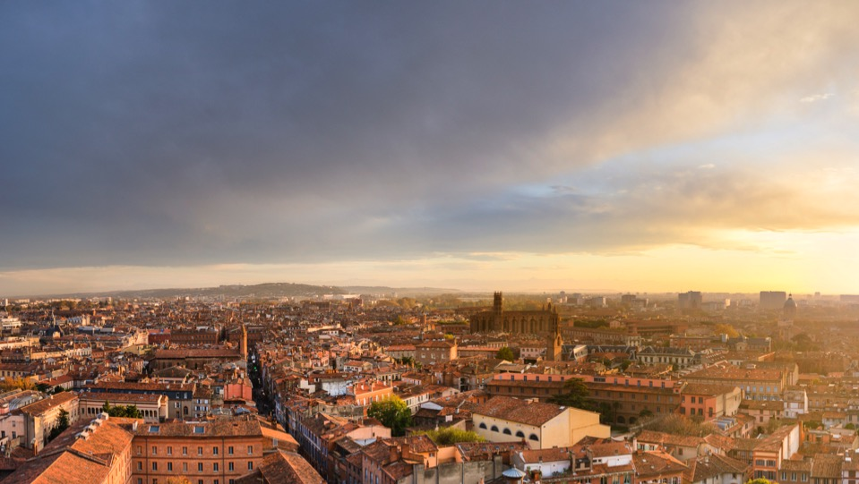
5. A renowned quality of life that attracts talents
One of the most outspread urban areas in France with 460km² compared to an average 285km² in Europe
A low population density (1 530 habitants/km²) facilitating the acquisition of individual housing
The French city favored by executives to work and live (APEC - 2014)
Most student-favored city in France
Best sports facilities in France (Ministry of the City, Youth and Sports, 2015)
2 238 hours of sunshine in 2015 (French average: 2 110 hours)
Close to nature 160 parks et gardens in the city 6 leisure areas covering 600ha 1000ha of green spaces 760km of cycle paths The Garonne River and 3 canals (Canal du Midi, Canal de Brienne et Canal Latéral à la Garonne)
2 000 years of history: 51 protected historical sites & 3 UNESCO World Heritage sites

Slide 35
5. A renowned quality of life that attracts talents
Great locations nearby
Montauban: « Ville d’Arts & d’Histoire », elected 4th most beautiful square in France
Albi: Cathédrale Sainte-Cécile – Museum Toulouse-Lautrec – UNESCO World Heritage site
Carcassonne: Medieval village, UNESCO World Heritage site
The Pyrenees: 38 ski resorts only 122km from Toulouse
144km away from The Mediterranean Sea and 233km away from The Atlantic Coast

Slide 36
Free and confidential assistance in each step of your set-up

Slide 37
Free and confidential assistance in each step of your set-up
Information on Toulouse
Set-up support
VIP Aftercare
Presentation of Toulouse
Provision of viable economic information and
Identification of business opportunities essential for the success of your project
Information on French company, tax and labor law
Education Tour
Organization of a 2-day education tour in order to meet potential local partners and clusters
Site-selection and help in finding the right mentoring network in Toulouse
Local recruiting support
Translation - Legal information - Diffusion of job offers - Preselection of applications
Contacts of recruitment agencies and head hunters
Public and private funding
Screening of key subsidies and loans - financial simulation - Guidance in subsidy document filings
Contacts of private investors
Contacts of local bilingual lawyers, tax consultants and banks
HR mobility support
Immigration: Information on residence permits and assistance in official procedures
VIP executives welcome service: Personalized city tour and visit of residential districts - Free museum passes and sports tickets - Information on international schools, associations or language schools - Contacts of relocation agencies
A Help Desk at your disposal for any question regarding your new business
Communication support and promotion of your new local establishment
Organization of a press conference
Help in drafting a press release
Social media communication (LinkedIn, Facebook, Twitter)
Local networking
Invitation to cultural and sports events
Monthly newsletters

Slide 38
5 reasons to Invest in Toulouse

